Slide 1
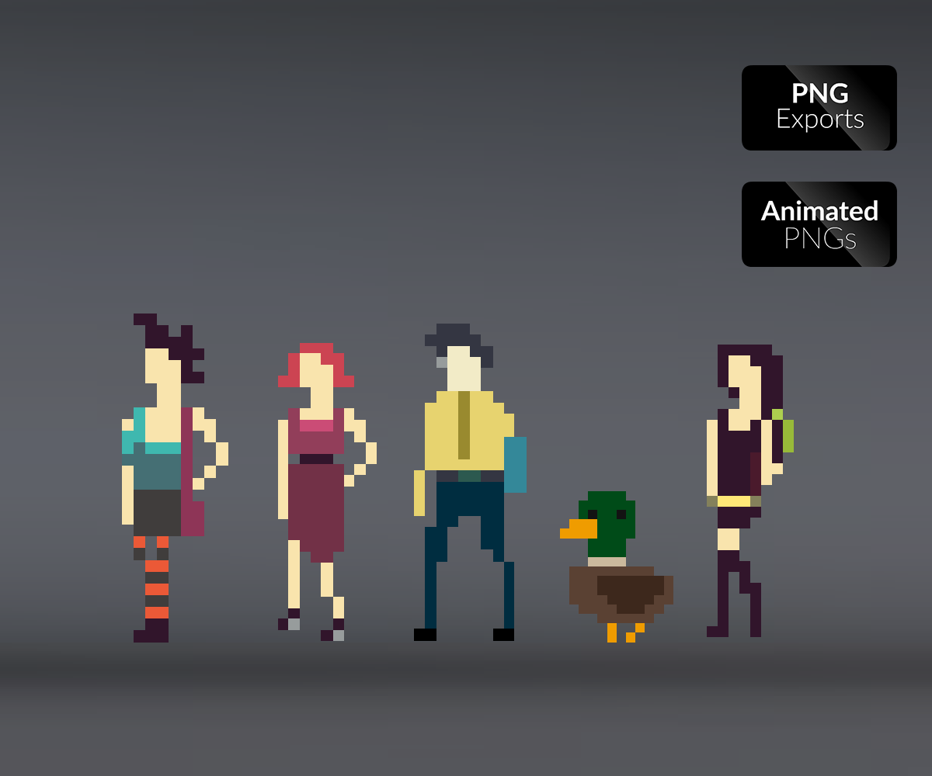
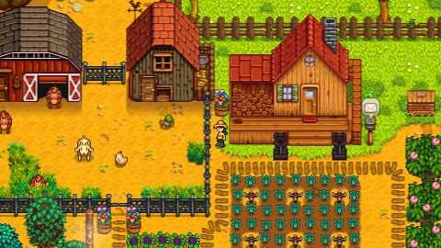
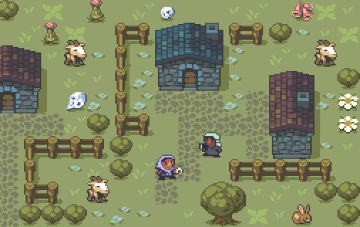
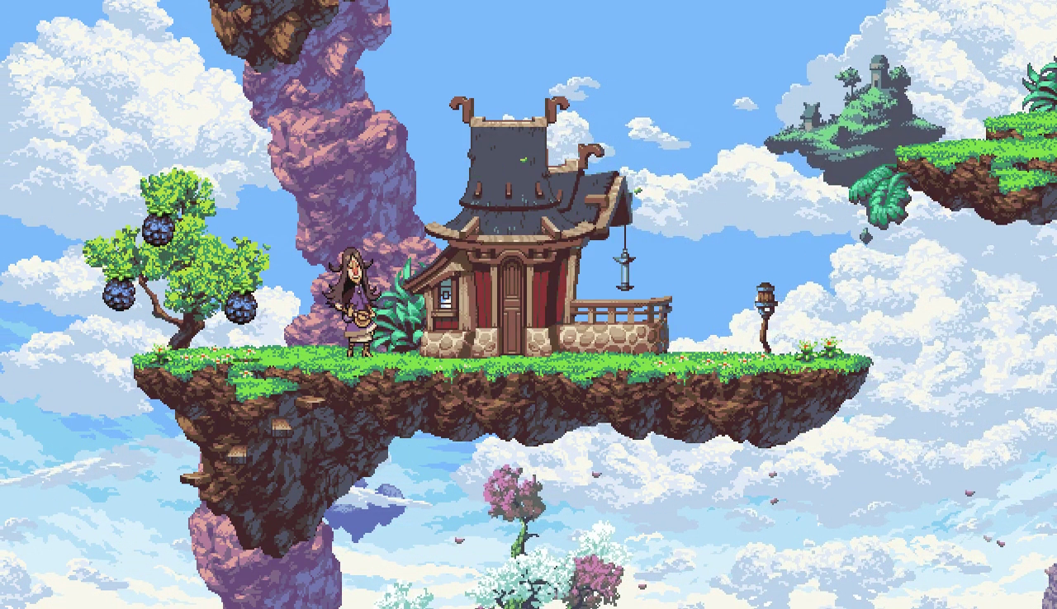
Pixel art
Art Style Research Document
There are various different styles of pixel art. This includes a detailed and high quality style, or a much more simplistic style, with not much detail on characters faces and objects around them other than what is necessary to convey what an object is.
With the time we have to create our game, we should probably aim for a more simplistic and easy to create art style. This would make it easy to get multiple jobs done quickly and we would still be able to convey what every object is in our maps.
If we had more time towards the end, more detailed pixel art could be a stretch goal, however using both higher detailed and low detailed pixel art combined in the final product would not make much sense at all. It would only make the game look like a mismatch of different styles and it would suffer for it.
Notes:
https://gameartpartners.com/downloads/pixel-university-collection/
https://www.slant.co/topics/6128/~pixel-art-games
http://dpadstudio.com/Blog/postHibit.html
https://www.pinterest.co.uk/pin/463378249151559680/
https://www.pinterest.co.uk/pin/380343131015751323/

Slide 2
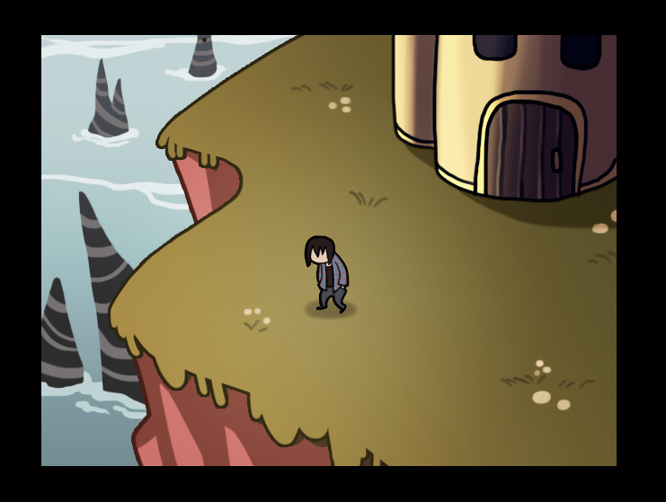
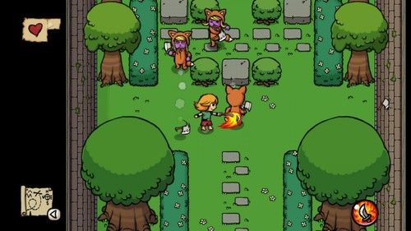
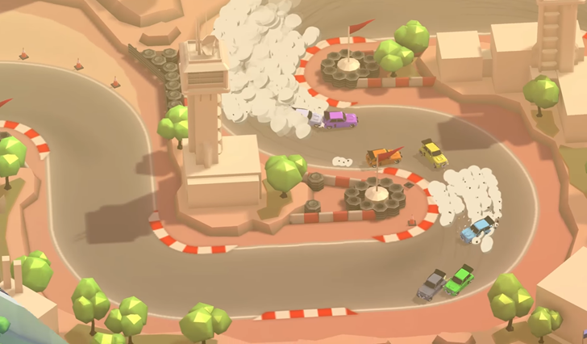
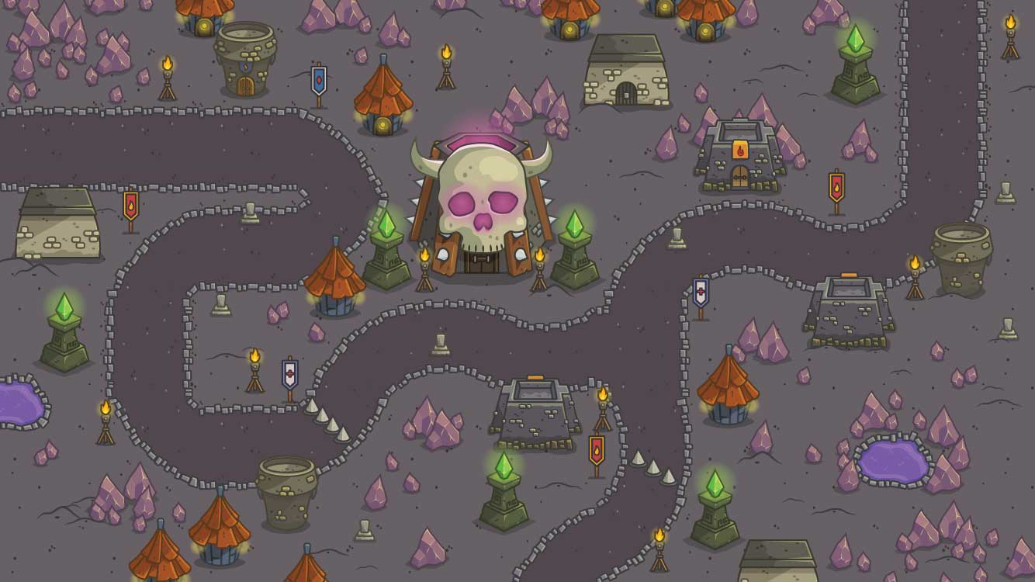
Cartoon
A cartoon art style could take much more time and effort to create than a pixel art style depending on how much detail is added to it. Again, just like pixel art, it can be either highly detailed, or have very little detail, with character with no faces and bare minimum limbs so that it’s easily notable as to what they are.
A cartoon art style could be more tricky and time consuming for our team with the time that we have so it might not be best to focus on this. If possible it would be best to use this art style as it looks the cleanest and could fit our game style quite well.
One thing that could prove to be an issue is that a more cartoon-like art style would appeal more so to a younger audience than what we’re aiming for. A lot of top down shooters also have a very pixel-like art style, or are at least inspired by it, so that might be the better route to go rather than a more childish cartoon art style.
Notes:
https://www.pinterest.co.uk/pin/395964992218177165/
https://cartoonsmart.com/top-down-levels-royalty-free-game-art/
http://community.stencyl.com/index.php?topic=3297.0
https://www.androidpolice.com/2016/09/03/hotlap-heroes-brings-top-down-local-racing-with-up-to-8-players-to-android-tv/

Slide 3
Colour Palette
A more sleek, clean and futuristic design would mean that we’d want to focus on bright colours. With our maps looking black and white to show the cleanliness and the pristine look to the setting.
Bold colours such as red and yellow could also be used to differentiate between certain areas in our game. It would also help landmark certain areas of our maps as the player would be able to easily recognise specific colours for specific parts of the map.
A more dirty and rough design for our theme would allow us to use much more muted and muddier colours. It would really set the feeling of a much more dystopian and lived in world. One issue that we could run into is having a lot of colours very similar to each other, which could lead to very similar looking maps in our game.
One positive of using a colour palette such as this, is that it allows us to have a much wider array of colours than if we were to stick to primarily white, black and very bold colours. We’d be able to make use of various shades of colours to set the feeling for each map, whether that be a dark forest, or a ruined apartment complex.

